Slide 1

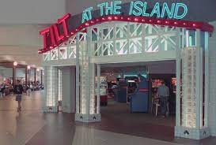
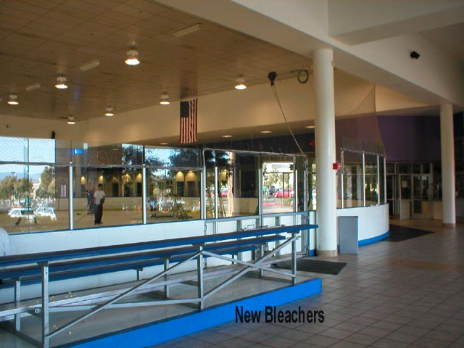
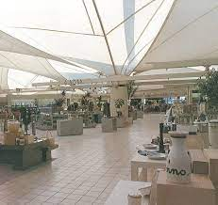
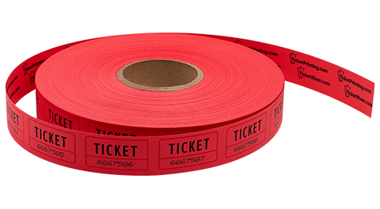
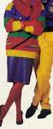
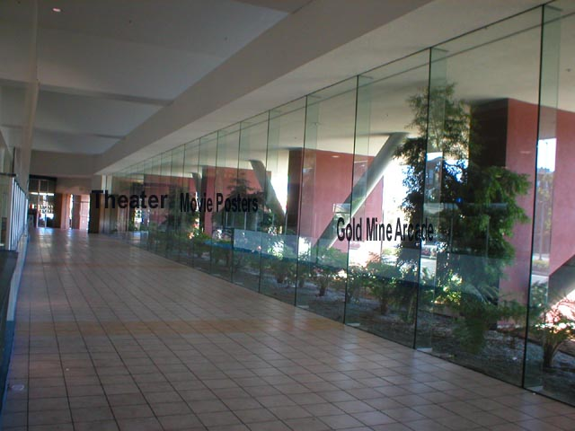
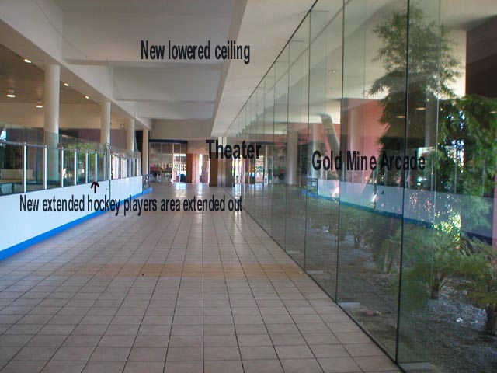
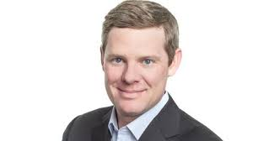
FBI
partner
Development
Marlin Ave
1986 Foster City, California
Shoppoing Spree.ext
VIRGINA:FBI:WMD
for Mall Shooter
1986 Mother took to event for childrnd shoopign spree
2014 41.CPVA.VIRIANG killing spree
[x] no
The idiom even looks like 6c WWI.marx(kaiers).VIRGINA.MVARY stole identy-idiot CEO?
2003 “Adam”
BUSTED
IPX angel merkel cournter srikie
IPX visa office shooter, LISA.HERMAN(Transl)GODMAN)-UNCLE CUM.ORIGINAL.CPVA 41.“P-I-Z-Z-A”

Slide 2
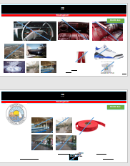
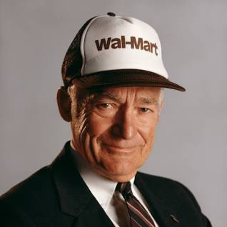
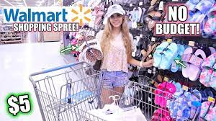
FBI
partner
Development
Shoppoign Spree.Ext.FOSTER CITY
Marlin Ave
§41.INT.§Stalking(alg sheep)

Slide 3
FBI
partner
Development
Marlin Ave
§41.INT.§Stalking(alg sheep)

Slide 4

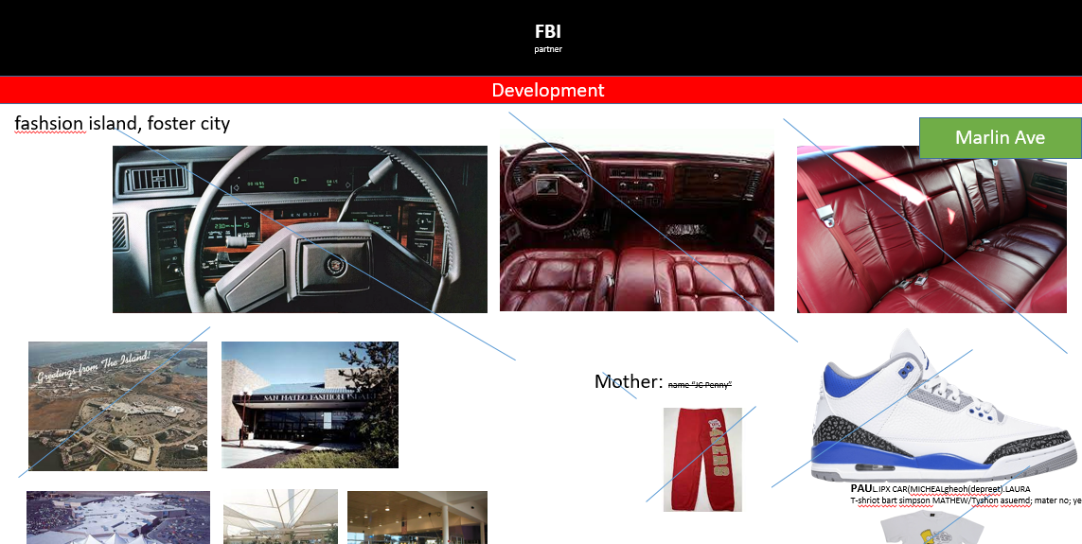
FBI
partner
Development
0.1
Marlin Ave

Slide 5
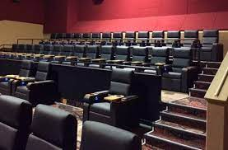

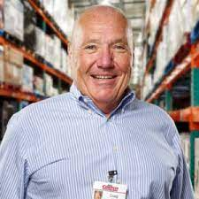
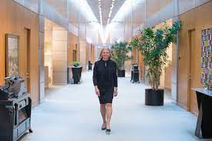

FBI
partner
Development
Marlin Ave
“tootsie”
LAURA

Slide 6
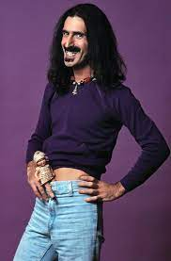
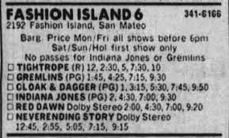

FBI
partner
Development
ATOMCLOCK(CPVA.SQ.CDCR Facebook
Marlin Ave
ATOMICLOCK(Mattenee,NAME CHENAE(free pizza)
Whats on the Matteneee?

Slide 7
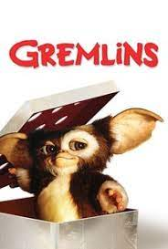
FBI
partner
Development
PG-13
Marlin Ave

Slide 8
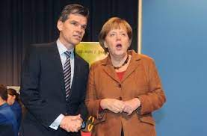
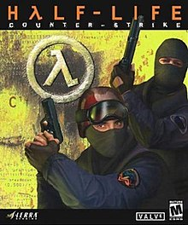
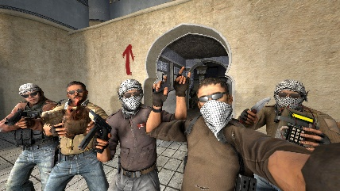
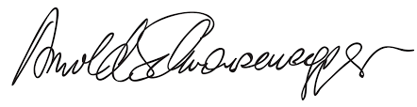

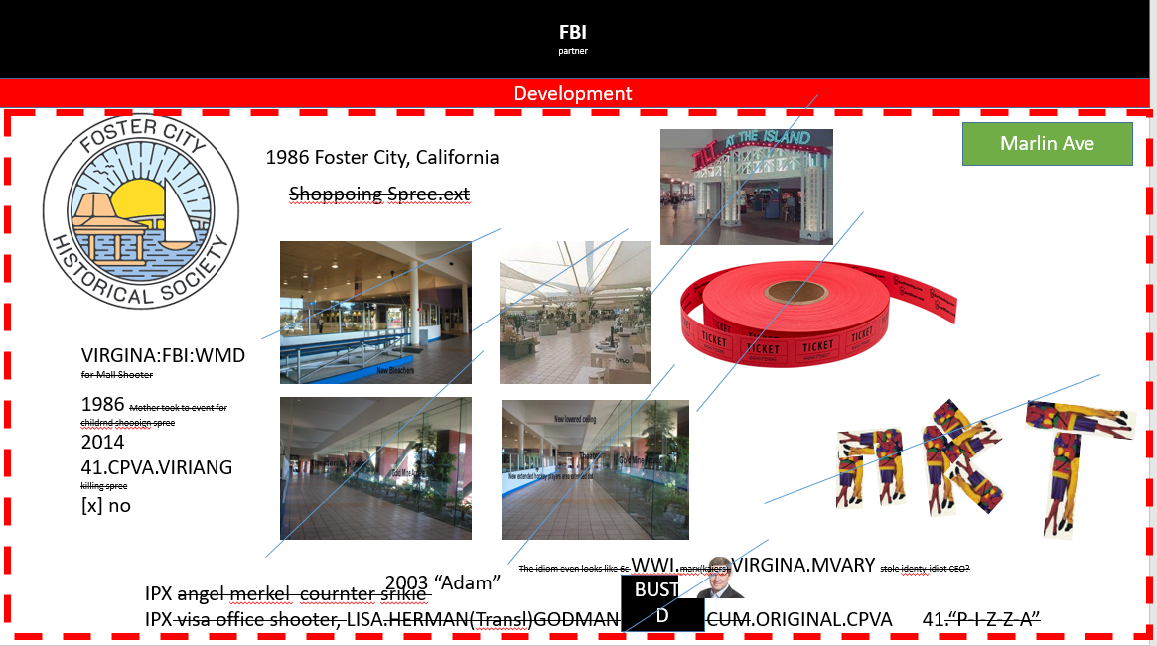



FBI
partner
Development
AUSCHWITZ:TORT-II
“Adam” FBI.marx.Cornly(iosu)
DEA(crack,daniel).Grohc(Who is god?, knight music)
MilkaUncle-1.DEA(bars)
ATOMCLOCK.CPVA.(Killing Spree)
VIRGINIA.sandy hook; intel processor, z/OS processor
Statement from President Joe Biden on Five Years Since the Shooting at Santa Fe High School

Slide 9
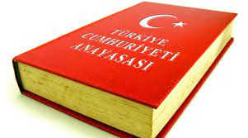
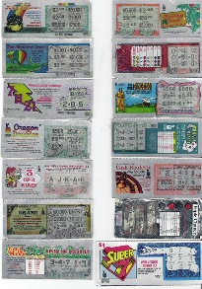
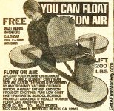
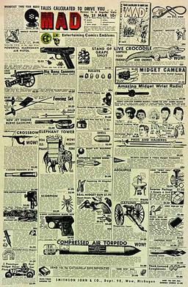
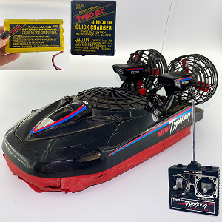
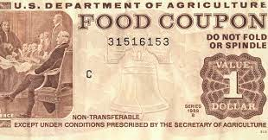
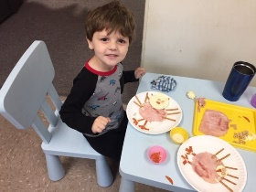
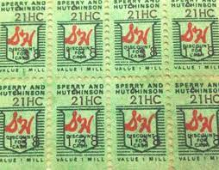
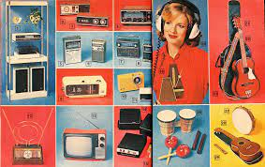
FBI
partner
Development
LARY.MIAMM: Apple.greenstampls
Marlin Ave
Constustoin.VIRIGNA
HOMCEI:NANA
Al Kaide
Apple.greenstampls
41.“Typhon” A Turkish word used in Euroep soe theing thye don’t kown what it is I belive.
KING.JFK41.(marx; childres thanksviin table; ginilin)
AOTMCLOCI(left:cooin
HOCIM:ANA, right :
whist; mother)
You can buy something for $10 that floats on water?
For free
41. assuedm: data to idtos from Foste rCity? Asuemd?2014 withough access or know about data

Slide 10
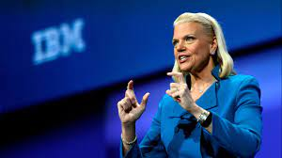
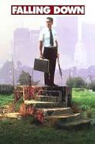
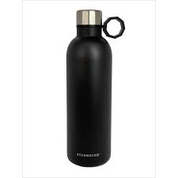
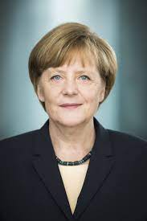
FBI
partner
Development
PG-17
CPVA
.ATOMICCLOCK
Marlin Ave
41.nonPoliceContentItem
MAINFRAME SECURITY
IBM
WebSphere
Police Sirens: 1:42PM

Slide 11
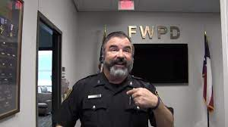
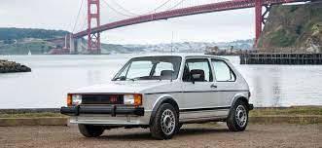
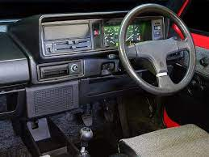
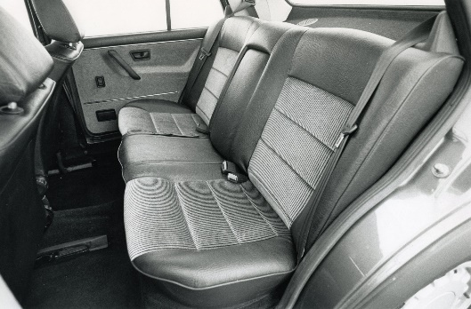
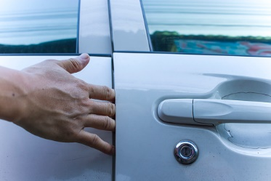
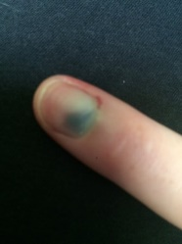
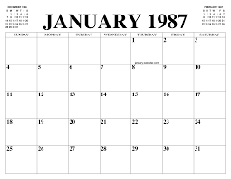
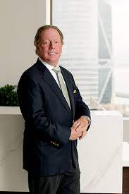
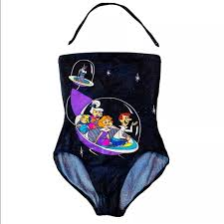
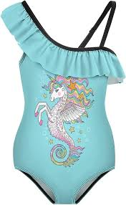
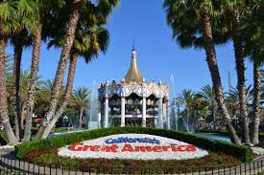
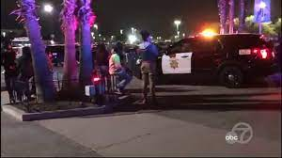
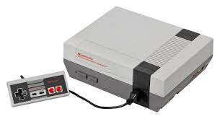
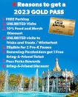

FBI
partner
Development
January 3rd, 1987
Saturday
Marlin Ave
Steve Meiers
Mike Cooley
Jennifer Cooley
Rebbeca Cooley
41
flea
I have a Nintendo
1D8723(1986): Girls Nintendo(very clean)
Mike

Slide 12




FBI
partner
Development
2017 Montoring (Grobahce(cooley) STAONFORM BASEBALL PRESIDENTAL THROW
Marlin Ave
Palestine Al-Kaida Woemn Suicide bomer- Father/Cathorlic
1987 January 4th, Sunday
SQ.qpple.tango
US: CARE BEARS.CPVA.marx
[x] no nonPOlcieQOS swim plastic toys
IPX: (delta).calc.CHARTS.DEA(cocain).apple.craig
1987 VIRGINA.MARY.IPX.LAKE TAHOE
REBECA
JFK
1997 Augusts REBECA
Seating agerment 3 popele steve,mike and yself: do yo want to play nintnedo
0.1 x/y CVPA.v2.male.girls on weekend
41.ATOMPHYSIC(hahn,IPX)
x

Slide 13




FBI
partner
Development
Kids
Marlin Ave
Saturday

Slide 14









FBI
partner
Development
Kids
Marlin Ave
Saturday
MILTIARY.HEIDERLBERG
St. Patrick-Henry
“Girls Blanket” TARGET
C++/LAW IPX KIT. “My cum”.Petersson
000.tw.pns
ATOMCLOCK(J5.0.IPX.amadeus,Jenny)
Other:
!INTENET PAYMENST
(laura,schutz)
INT.REBECA.Gorhch(cooley).flea.calforniacation
Ancestroy.com
0.1 Jason Williams 1st dubline of all citiznes

Slide 15



FBI
partner
Development
Kids
0.1 VIINGA.MARY 1992 Hansa Park, Strbergarten
Marlin Ave
Saturday
US: CARE BEARS.CPVA.marx
[x] no nonPOlcieQOS swim plastic toys
1985 Santa Cruz, California
“Beach Ball”
(delat).ATOMBOMB(sap hahn gheoho(dr))
CIVIL CODE.DEFAULT 0.1 sexabuse
R
1994 HOMICDIE:SNSTORE:LARRY: larry gest out of boat iwith ereiected penis on naekd ilands for ¼. As redhsouse ¼ was enough
IPX
1984 1/4.“Brother” gi joe boat swiing

Slide 16



FBI
partner
Development
Kids
1986
Marlin Ave
1994
Saturday
Shortname: “Bubu”
Shortname: “Bu” LARRY

Slide 17






FBI
partner
Development
Kids
1986
Marlin Ave
Saturday
bildzeitung 1991 january

Slide 18













FBI
partner
Development
41.!Auschitz
SATURUDAY
6:00 AM
1996 Pope.St. Martin.Angela Heaven/Himmler/Sky
Do you remember waking up Sature Mornign with Carootns?
41. No PAUL.St. Marting.Angel.WARSHAU.POLEN
1996
New Game ( Wake up)
8am !druck Saturday
PG+16
EU

Slide 19





FBI
partner
Development
Kids
1986
Marlin Ave
Saturday
Computer
Nebori Sawing then dead;started sawing
TERMAIN.JOSHE.unimog.truck.grey.saw
HOMCIE:BILL; HOMCE:NANA(elebeth)
!WW2
41.!Auschitz

Slide 20


FBI
partner
Development
PG 17
Marlin Ave
1986
Tesla:
NAMCE CHANGE(free pizza, we chose the name Jason. Brad and Gary)

Slide 21















FBI
partner
Development
PG +17
Marlin Ave
PG 10
Avg.Can I watch Freddy Kurgger
41.
Stanford
TEMINATOR.JOSPHE.visa
IPS.visa
41.
Danger Mouse 0.1 !Mr. Maggo(calc.eval.radius)
CVPA.§Stalking
Zuckerber,Robert:trains;auschiwtz
Documents.eval.review
GENENTECH
!.AUSCHWITH
HOMICIDE:NANA
facebook
San Francisco Indoor Soccer.Pope.St.Anselm
Danger Bob
Strok City (tim)

Slide 22




FBI
partner
Development
Docs
Marlin Ave
PG 17
1987
A5 KA-Köln
Don’t Take Hitchhikers
2009
Phil(kim).hitchhicker 2014 CPVA.parking cisco.montriong.hcihier

Slide 23














FBI
partner
Development
N/E/W/S
Kids
Marlin Ave
Custom Screws
Zoll.de(schrauben)
Thomas-is-dieter
(der schrauber)
41
AUSCHWITZ
R
FURNISS
Screwing someone
To get layed
SQ.CDCR(jim,she went to gym).NAHCENGE(freepizza)
F-u-c-k
Kids
WWI.marx(Kaiser.franz.sissi.ext.jenny.falco.amdeuse)
Dark hair; navy
Living room
Search: 12 slides: MATT(FAHTER: NAVY SEAL “View” Disney Blond Male

Slide 24









FBI
partner
Development
Kids
Marlin Ave
Kids
nonPoliceQOS.nonPoliceChart.
CHART
Kids
Good Morning
Wake up
New Game
Or Turbo Teen?
!AVAILBILITY
0.001 0.1 x/y navy girflrind I am leaving
!TORT-3.eval
(delta)
nonPolcieCfg[].000.marx.WWI.marx0.1WW2.marx

Slide 25



FBI
partner
Development
Kids
Arun Glasses
Marlin Ave
Arthur
Ar
2010 montriong 2005
Shusandto Patit
MILITARY:JOEL
AUSCHIWTZ: hti by train
1994
“Adam”
HOMCIDE:IS-A-BELL(abele,donimquei; glu)

